Slide 1
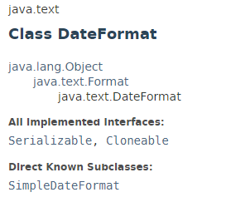
DateFormat
DateFormat is an abstract class for date/time formatting subclasses which formats and parses dates or time in a language-independent manner.
The date/time formatting subclass, such as SimpleDateFormat, allows for formatting (i.e., date → text), parsing (text → date), and normalization. The date is represented as a Date object or as the milliseconds since January 1, 1970, 00:00:00 GMT.
DateFormat provides many class methods for obtaining default date/time formatters based on the default or a given locale and a number of formatting styles. The formatting styles include FULL, LONG, MEDIUM, and SHORT.
DateFormat helps you to format and parse dates for any locale

Slide 2
DateFormat
https://docs.oracle.com/javase/8/docs/api/index.html?java/text/DateFormat.html

